Slide 1
First Order Logic
in AI
Artificial Intelligence - Presentation

Slide 2
HI!
I am K-gen, I am a passionate programmer and a music enthusiast. In my free time, I like to play CS 2, and read books.
Notes:
So, as I was thinking about how to present the idea about FOL to you, I began to thought about what is logic?

Slide 3
Logic?
What is meant by Logic?

Slide 4
Why do we need logic?
Why?
Notes:
Logic allows us to express very complicated and big things (like modelling the world knowledge) by using some kind of formulas.

Slide 5
Types of Logics
Propositional logic with only Horn clauses
Propositional logic
Modal logic
First-order logic with only Horn clauses
First-order logic
Second-order logic
Notes:
Today, we are briefly talking about Propositional Logic, and bring the focus on FOL why PL is not enough

Slide 6
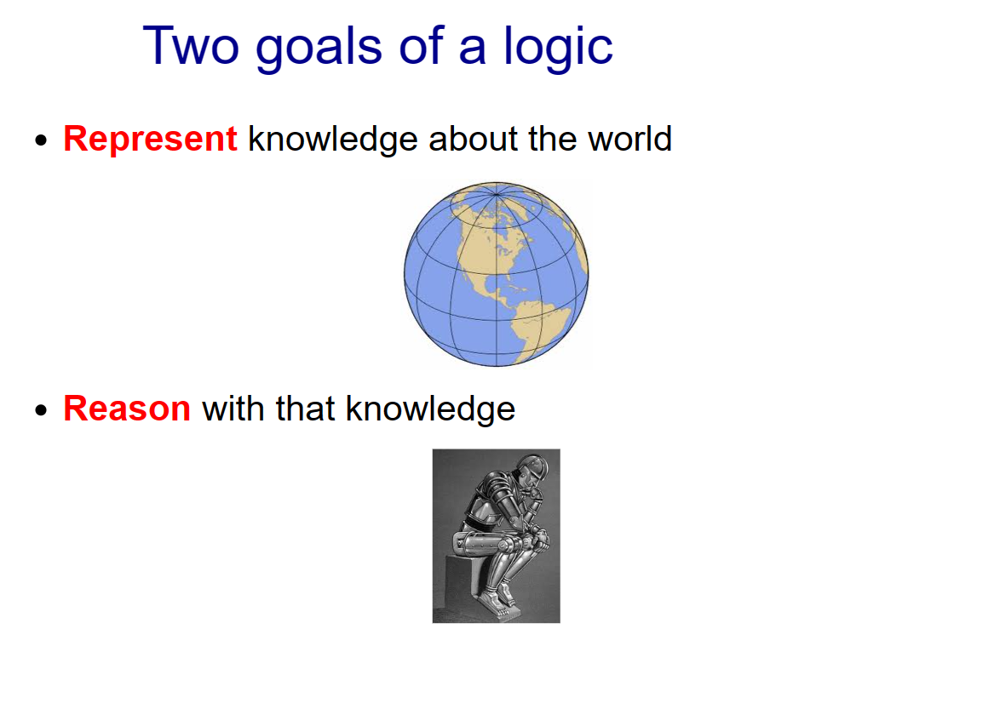
Notes:
Even hardware can represent the knowledge but we have to use that knowledge in a way to reason with it.

Slide 7
Two Goals of mine
Present this topic to you very clearly
Make you learned something new after this time

Slide 8
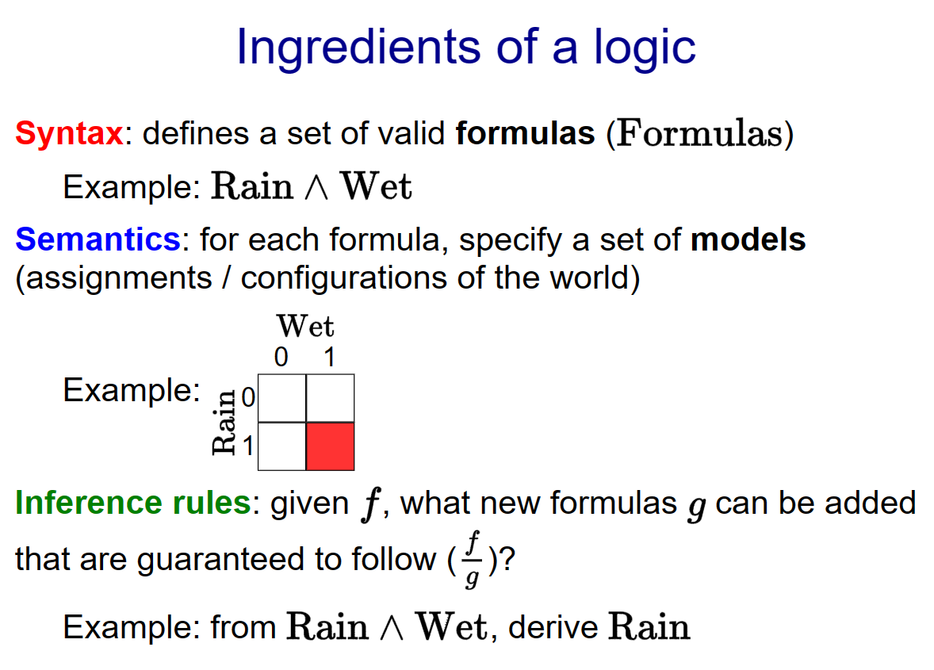
Notes:
Syntax means what kind of expression are valid. Semantics specifies the meaning of a formula.
Inference rules allow us to take various formula to do different thing. For example, if I tell you that it's raining and wet, then you should be able to conclude that it is also raining (obviously)

Slide 9
Syntax versus Semantics
Syntax: what are valid expressions in the language?
Semantics: what do these expressions mean?
Different syntax, same semantics (5):
2 + 3 ←—------------→ 3 + 2
Notes:
Even if they are two different syntax they represent the same semantics

Slide 10
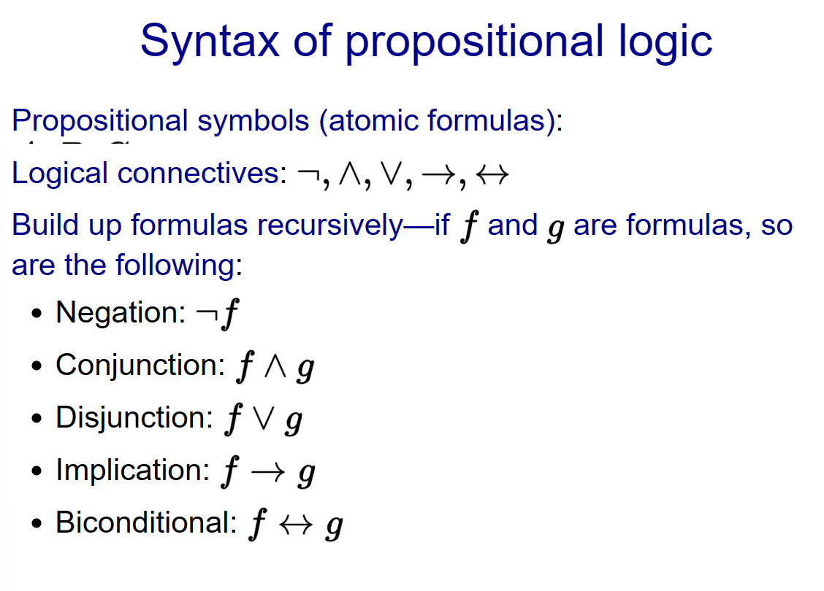
Notes:
These are some syntax in PL

Slide 11
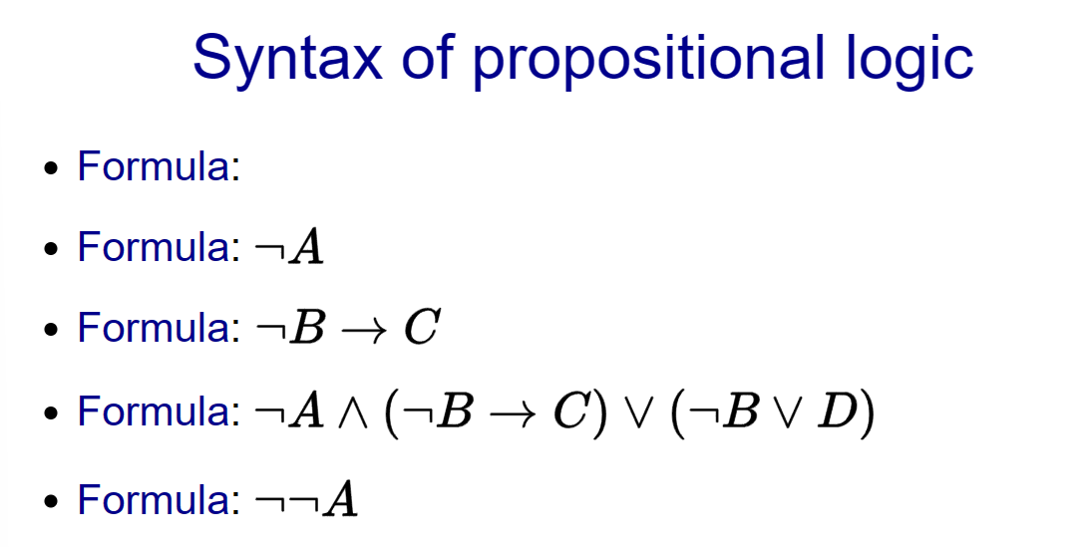
Notes:
And here are some formulas

Slide 12
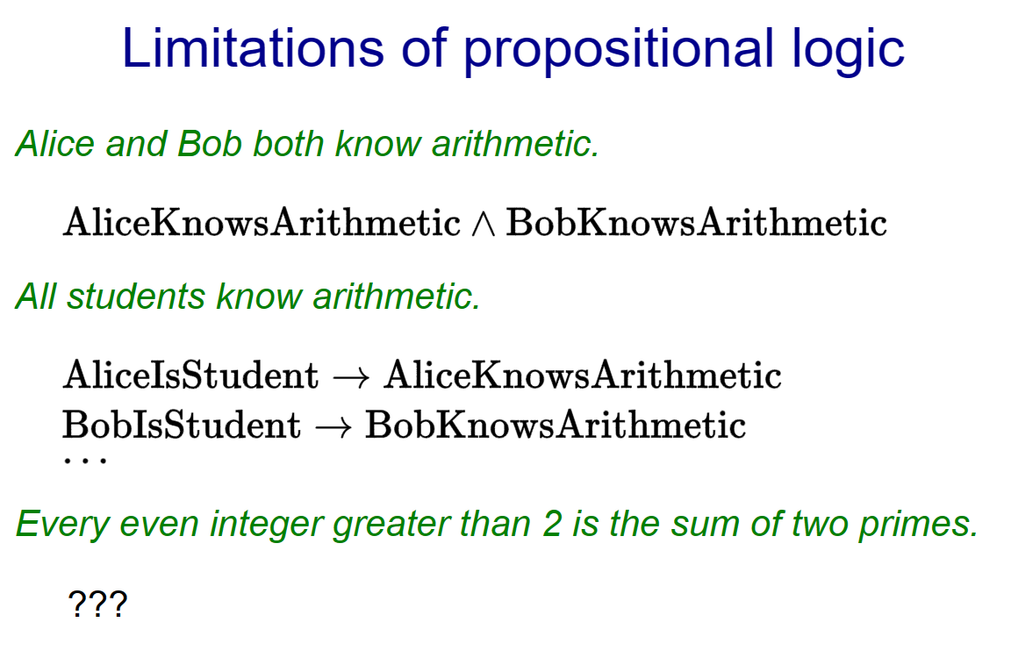
Notes:
If the goal of logic is to be able to express facts in the world in a compact way, let us ask ourselves if propositional logic is enough.
Some facts can be expressed in propositional logic, but it is very clunky, having to instantiate many different formulas. Others simply can't be expressed at all, because we would need to use an infinite number of formulas.

Slide 13
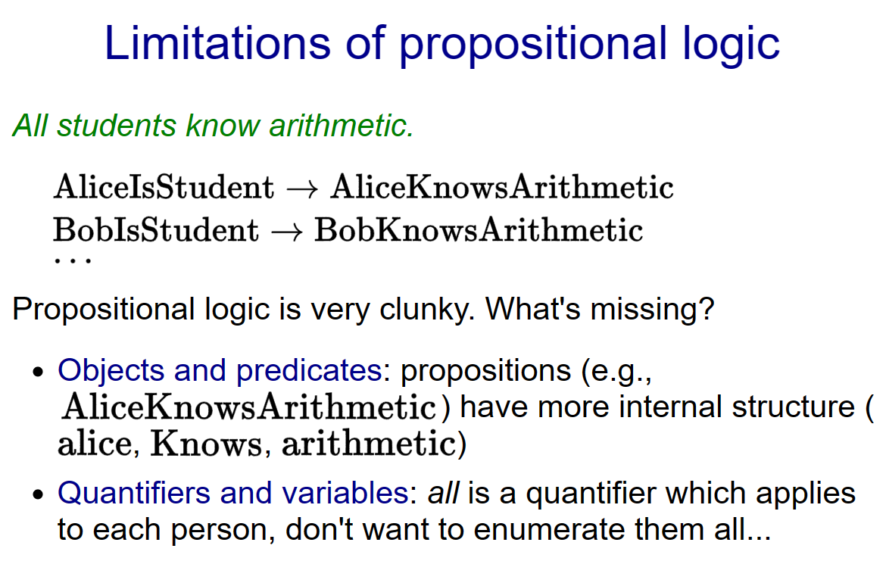
Notes:
What's missing? The key conceptual observation is that the world is not just a bunch of atomic facts, but that each fact is actually made out of objects and predicates on those objects.
Once facts are decomposed in this way, we can use quantifiers and variables to implicitly define a huge (and possibly infinite) number of facts with one compact formula. Again, where logic excels is the ability to represent complex things via simple means.

Slide 14
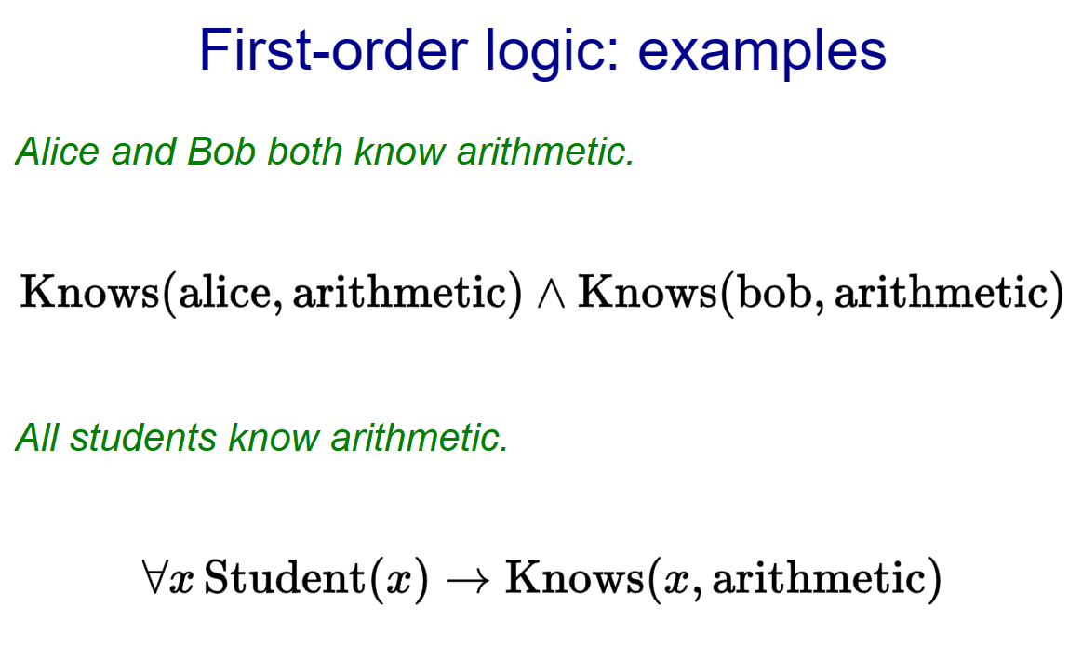
Notes:
Before formally defining things, let's look at two examples. First-order logic is basically propositional logic with a few more symbols.

Slide 15
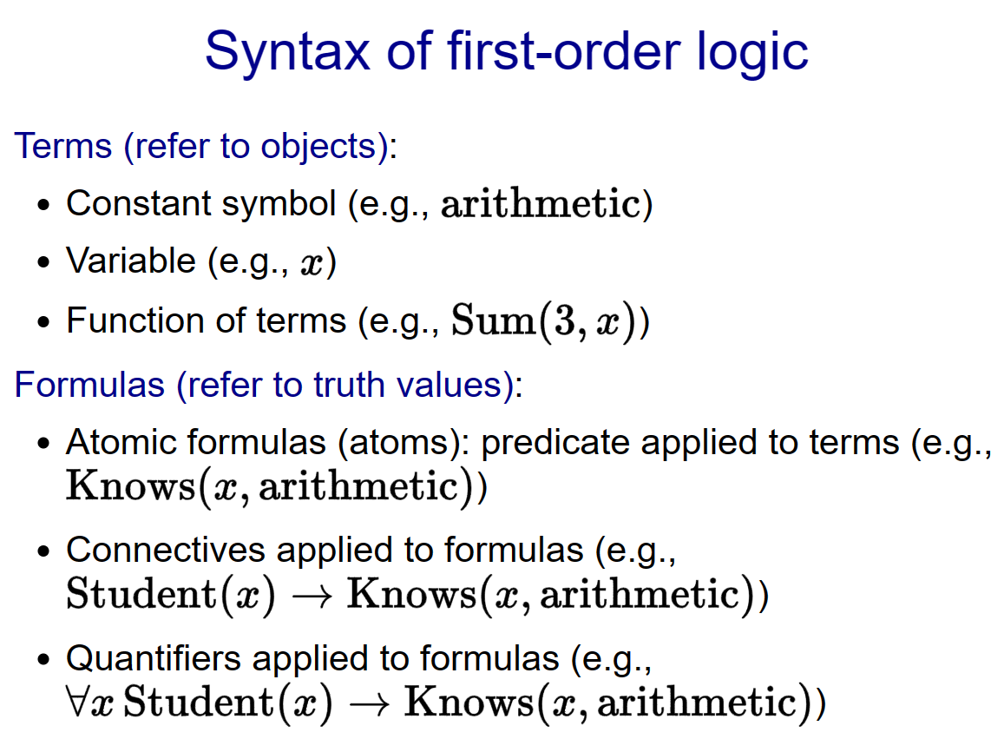
Notes:
In propositional logic, everything was a formula (or a connective). In first-order logic, there are two types of beasts: terms and formulas. There are three types of terms: constant symbols (which refer to specific objects), variables (which refer to some unspecified object to be determined by quantifiers), and functions (which is a function applied to a set of arguments which are themselves terms).

Slide 16
Identifiers
Existential quantification
Universal quantification
∀
∃
∀x P(x)
∃ x P(x)

Slide 17
Universal Quantification
Universal quantification
"For all x, P(x) holds",
"for each x, P(x) holds" or
“for every x, P(x) holds"
"All CU CS majors should take an AI course." could be transformed into the
propositional form, ∀x P(x)
P(x) is the predicate denoting: x should take an AI course, where x represents a CU CS major.
This quantified expression asserts that for all x, P(x) is true.
∀
∀x P(x)

Slide 18
Existential quantification
Existential quantification
"There exists an x such that P(x)"
"There is at least one x such that P(x)"
"Someone hates Mac computers" could be transformed into the
propositional form, ∃xH(x)
H(x) is the predicate denoting: x hates Mac computers., where x represents all individuals..
This quantified expression asserts that there exists x, P(x) is true.
∃
∃xH(x)
Notes:
X can be me, professor V oy my friend Gio

Slide 19
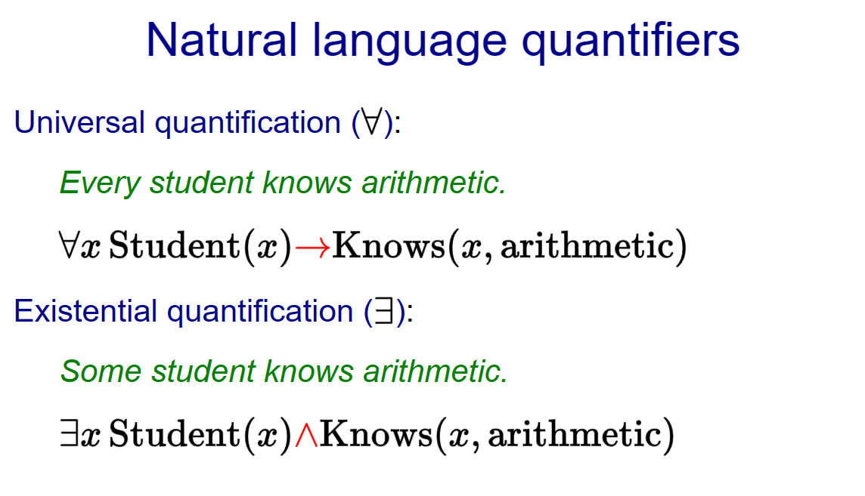
Notes:
Every can be thought of as taking two arguments and (e.g., student and knows arithmetic). The connective between and is an implication (not conjunction, which is a common mistake). This makes sense because when we talk about every , we are only restricting our attention to objects for which is true. Implication does exactly that.
On the other hand, the connective for existential quantification is conjunction, because we're asking for an object such that and both hold.

Slide 20
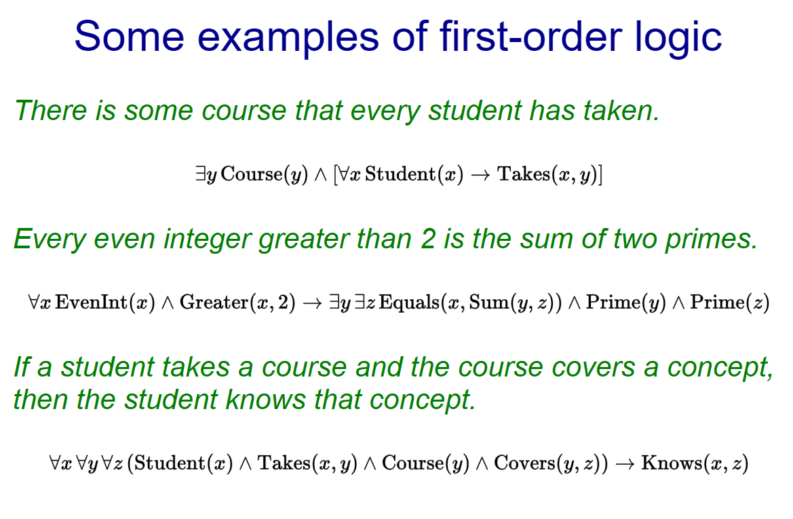

Slide 21
Propositional Logic
It is a way to data representation in a simple logical form.
Such that:- TRUE or FALSE.

Slide 22
Propositional Logic
Propositional logic is declarative
Propositional logic has very limited expressive power
Propositional logic is compositional
Propositional logic allows partial/disjunctive/negated information(unlike most data structures and databases)
Meaning in propositional logic is context-independent(unlike natural language, where meaning depends on context)

Slide 23
First Order Logic
It is a robust technique to represent objects as well as their relationships. Unlike propositional logic, First Order Logic in Artificial Intelligence doesn't only include facts but also different other entities like objects, relations, functions.

Slide 24

Just a picture from Web.

Slide 25

SWI-PROLOG
This is the tool that uses the concept of FOL.
Notes:
This is one of the top example to show the FOL demonstration

Slide 26
Simple, yet very powerful
https://www.swi-prolog.org/Download.html

Slide 27
Open source - GitHub
https://github.com/SWI-Prolog
Notes:
If you want to contribute then,

Slide 28
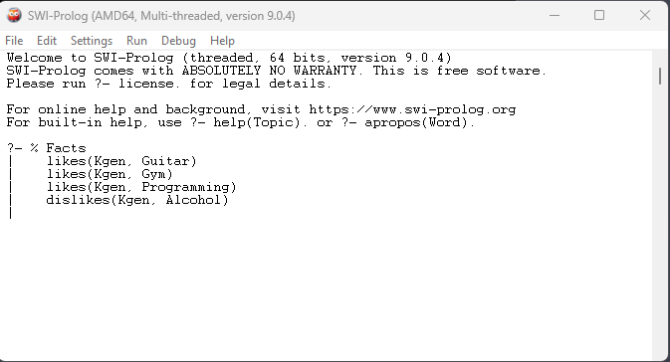
THIS IS A CLI

Slide 29
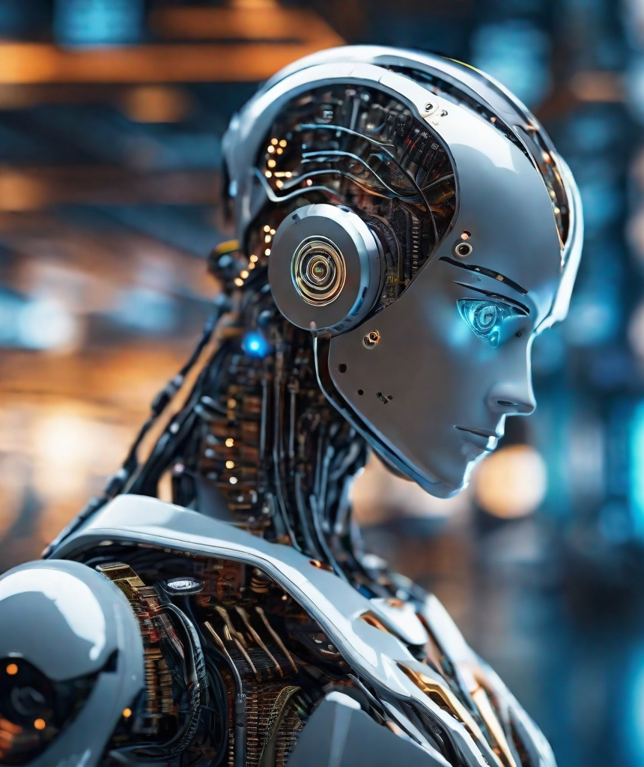
Ok, let’s see the real example
I will run the actual program where I have interpreted the meaningful examples.

Slide 30
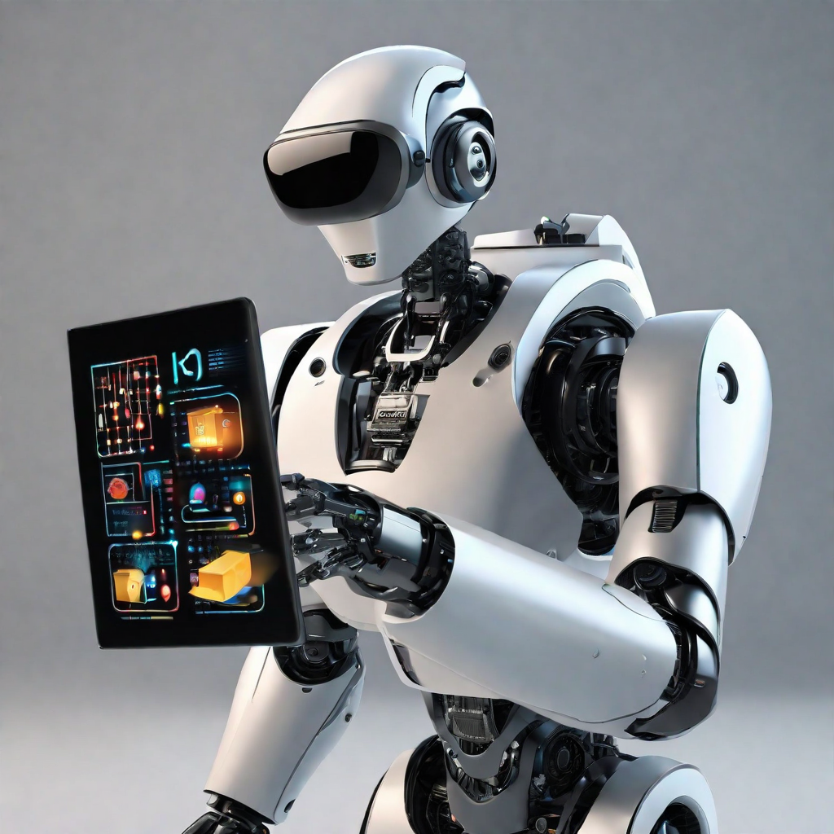
Just a picture from Web.

Slide 31
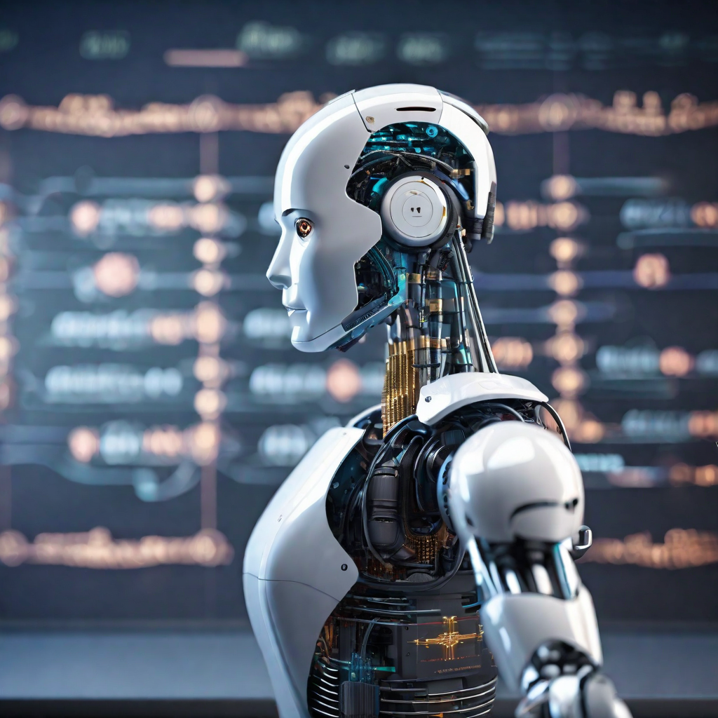
Just a picture from Web.
Notes:
The reason I kept this picture here is, I feel amazed by looking at this robot.

Slide 32
Ethical/Social Issues
The major concern of AI

Slide 33
Ethical/Social Issues
Bias and Fairness
Transparency and Accountability
Privacy Concerns:
Job Displacement:
Security Risks:
Explainability:
others

Slide 34
Ethical/Social Issues
Bias and Fairness
Security Risks
The use of First-Order Logic (FOL) in AI systems may inherit biases present in the data used for training. This can lead to unfair or discriminatory outcomes, reinforcing existing social biases.
AI systems using FOL may be susceptible to adversarial attacks, where malicious actors manipulate input data to deceive the system. Ensuring robust security measures is essential to prevent unauthorized access and manipulation of AI models.

Slide 35
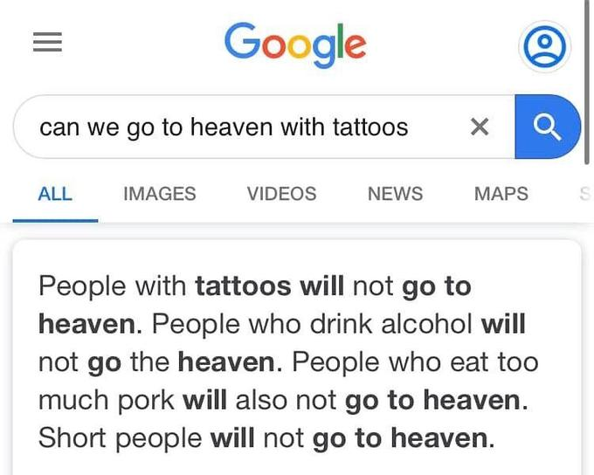
Notes:
Biasness like this causes too much problem, specially short people like me.

Slide 36
Economics and Company Profiles
FOL

Slide 37
Economics and Company Profiles
Economic Impact: The use of FOL in AI has significant economic implications. Companies adopting these technologies may experience increased efficiency, reduced operational costs, and improved decision-making. However, there may also be economic challenges, such as job displacement and the need for substantial investments in AI infrastructure.

Slide 38
Company Profiles
Google: Known for incorporating FOL in various AI applications, Google utilizes advanced logic systems to enhance search algorithms, language processing, and other services.
IBM: IBM employs FOL in its AI solutions, particularly in areas like healthcare and finance, demonstrating the versatility of these technologies across industries.
Amazon: Amazon's use of FOL is notable in its recommendation systems and logistics optimization, showcasing the impact on customer experience and operational efficiency.
Tesla: Tesla utilizes FOL in its autonomous driving technology, showcasing the role of logic-based AI in the automotive industry.

Slide 39
So far we covered
Propositional Logic
What is FOL?
Modus ponens
Mathematical identifier
Ethical issue & Economics
SWI-PROLOG
And why it is limited to certain functions
Symbols & syntax
How to create one?
Universal & Existential identifiers
And how to manage them
How to download & How to use?

Slide 40
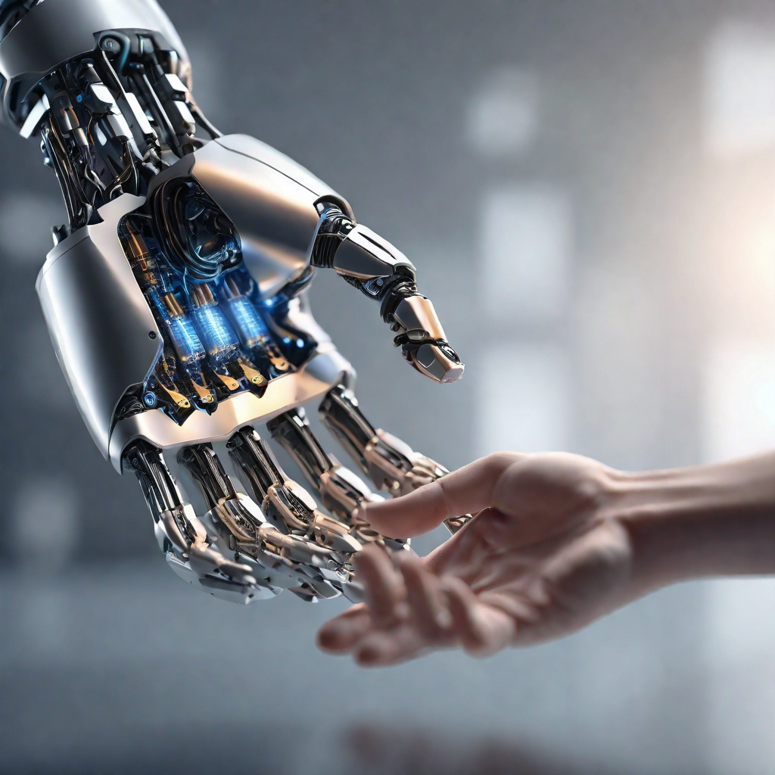
Summary
Propositional logic assumes world contains only facts.
first-order logic considers the world contains objects, relations, functions
Making modus ponens (If then therefore)
FOL consists of syntax & semantics
Learnt about existential & universal identifiers
Why Ethical/Social issues is concerning as well as economics & company profiles
Learnt about downloading and using the SWI-PROLOG
Notes:
Describe symbols and semantics

Slide 41
Questions please?
So, it is your turn to ask me questions.
Notes:
I will reply with best of my knowledge and ability

Slide 42
Fancy stuff isn’t gonna work, unless you learnt the fundamentals.
Randy Pausch
Notes:
A former professor in Carnegie Mellon, this has been stuck with me forever.

Slide 43

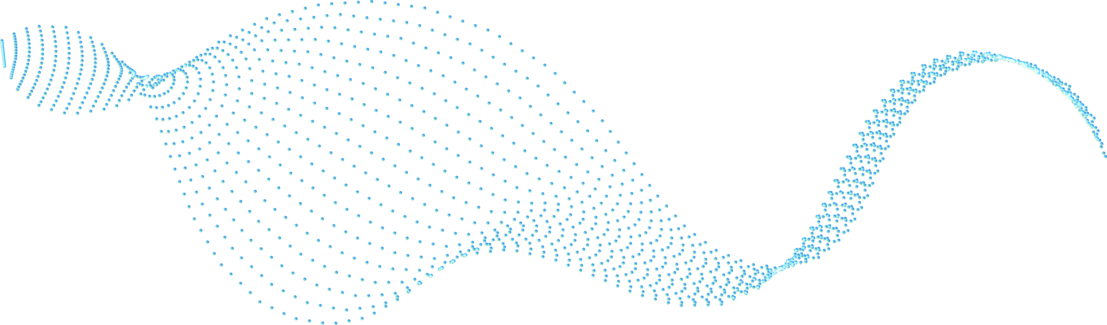


Thank You for watching
If you have any questions?
kkhatri@caldwell.edu
862-XXX-XXXX
Caldwell Univesity
Notes:
This is one of the top example to show the FOL demonstration

Slide 44
Work citation
References:
First-order logic in AI. Scaler. https://www.scaler.com/topics/artificial-intelligence-tutorial/first-order-logic-in-ai/
First-order logic in artificial intelligence. JavaTpoint. https://www.javatpoint.com/first-order-logic-in-artificial-intelligence
What is First-order Logic in Artificial Intelligence? Educative. https://www.educative.io/answers/what-is-first-order-logic-in-artificial-intelligence
First-order Logic. AutoBlocks Glossary. https://www.autoblocks.ai/glossary/first-order-logic

